Slide 1
Iterative Solutions
(Newton)

Slide 2
Iterative Solutions
Why?
Iteration
Exercise

Slide 3
Why?
We will encounter transcendental equations in which we can’t solve directly for one of the variables of interest
In some cases we will be able to use an iterative method to get better and better estimates of the answer we want

Slide 4
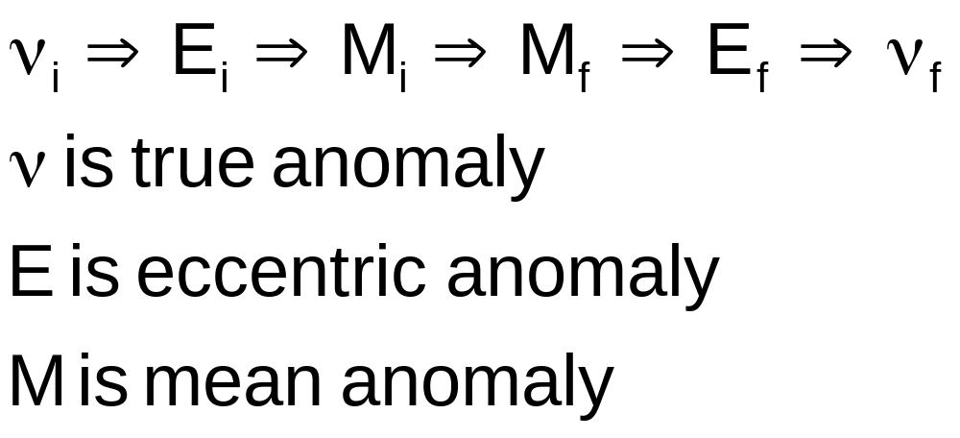
Iteration
When propagating forward orbital elements, we use the following sequence from Astro 310

Slide 5
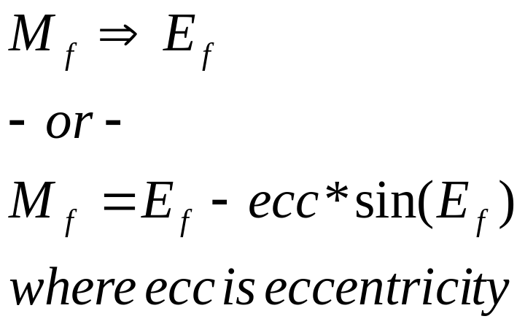
Iteration
The problem is in the step from mean anomaly final to eccentric anomaly final
We can’t solve directly for eccentric anomaly

Slide 6
Iteration
We turn to Newton’s method of approximating roots (which in turn is derived from the Taylor Series)
Newton’s Method
  f(E)=0
  E_{n+1}=E_{n}-f(E_{n})/f’(E_{n})
  We guess an E_{n} and then get an E_{n+1} which is a better estimate for E_{n}
  Then we use that value as the new guess for E_{n}
  The process continues until E_{n+1} is “close enough”

Slide 7
Iteration
How do we implement this?
For our problem:
  f(E)=M-(E-ecc*sin(E))=0
  hence
  f’(E)=-(1-ecc*cos(E))
  Then (we add substcripts to show old guesses of E (n) and new better estimates of E (n+1), resulting in…
  E_{n+1}=E_{n}+ (M-(E_{n}-ecc*sin(E_{n}))) / (1-ecc*cos(E_{n}))

Slide 8
Iteration
What do we use for our first guess of E_{n}?
We want something close to the real value, and since most of our orbits will be close to circular, M will be close to E (and will definitely be in the same half plane)
So mean anomaly final M_{f} is a good first guess
***Be careful! We must work this problem in radians in order to get the correct solution

Slide 9
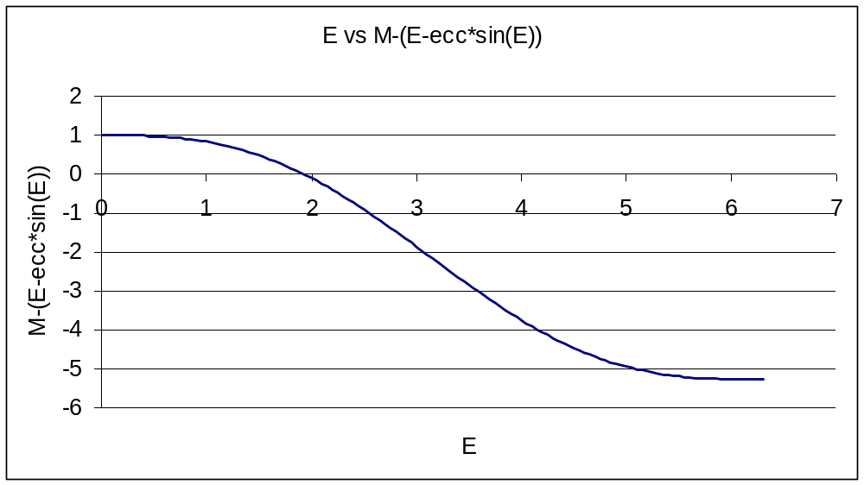
Iteration— A Graphical Look
Here is the curve of the function that we are trying to drive to zero. (M=1 & ecc = .99 find E)

Slide 10
Iteration— A Graphical Look
E vs M-(E-ecc*sin(E))
2
B
1
C
0
A
E
-1
0
1
2
3
4
5
6
7
D
M-(E-ecc*sin(E))
-2
A-start at our guess of 1
B-find slope of curve here
C-find new estimate of zero crossing
D-find slope of curve here
E-find new estimate of zero crossing, etc.
-3
-4
-5
-6
E

Slide 11
Example
Given
  M_{f} = 1.5 rad
  ecc = 0.1
Find
  E_{f}

Slide 12
Example
First guess for En is Mf (=1.5)
  E_{n+1}=E_{n}+ (M-(E_{n}-ecc*sin(E_{n}))) / (1-ecc*cos(E_{n}))
  E_{n+1}= 1.5+ (1.5-(1.5-0.1*sin(1.5))) / (1-0.1*cos(1.5))
  E_{n+1}= 1.6005
Next guess for En is E_{n+1}
  E_{n+1}= 1.6005+ (1.5-(1.6005-0.1*sin(1.6005))) / (1-0.1*cos(1.6005))
  E_{n+1}= 1.6000
  Notice how M (or 1.5) stays the same in the second and following iterations

Slide 13
Example
Now continue for a few more iterations and list all the results
  E_{n} = 1.5000
  E_{n+1}= 1.6005 (iteration 1)
  E_{n+1}= 1.6000 (iteration 2)
  E_{n+1}= 1.6000 (iteration 3)
How do we know when to stop?
The number of digits that match from iteration to iteration give us a good idea of how accurate the answer is.
Here it looks like after iteration 3 there are at least 5 significant digits of accuracy in the answer

Slide 14
Convergence Criteria
For future work we will use the criteria of 1E-8 (or 10⁻⁸) as our difference criteria to finish iterating
In terms closer to Matlab language
  If abs(En+1 – En) < 1E-8 then “stop iterating”

Slide 15
Question!
The brute force method that we learned (or will learn) in Astro 310 is much easier to use. Why use Newton’s method?
We use Newton’s method because it converges on the correct answer in fewer steps than the brute force method
In some cases, brute force won’t converge to the accuracy that is desired (Newton will)

Slide 16
Exercises
For more information on using Newton’s method of iteration to solve this problem, see Bate, Mueller and White’s “Fundamentals of Astrodynamics,” pages 220-222.

Slide 17
More Information
Write a Matlab function to implement Newton’s method
How do you test your program to make sure the answer is correct?

